Slide 1


ORIENTAL COLLEGE OF TECHNOLOGY
Oriental Campus, Opp. Patel Nagar, Raisen Road, Bhopal – 462021 (M.P) India
Phone : 0755 – 2529015, 2529016, 2529057, 2529058, Fax : 0755 – 2529472
Email : directoroct@oriental.ac.in Website : www.oriental.ac.in
Home Automation System
( Internet of Things )
A
Project Work
Submitted as Minor Project in Partial fulfilment for the award of Graduate Degree in Bachelor of Engineering in Computer Science & Engineering.
Submitted To
RAJIV GANDHI PROUDYOGIKI VISHWAVIDYALAYA
BHOPAL, (M.P.)
Submitted By
Kritik Shivanshu [0126CS171046]
Jaya Rai [0126CS171041]
Divyanshi Singhal [0126CS171031]
Under the Guidance of
Prof. Apoorva Shrivastava
( Department of Computer Science & Engineering )

Slide 2
ORIENTAL COLLEGE OF TECHNOLOGY
Oriental Campus, Opp. Patel Nagar, Raisen Road, Bhopal – 462021 (M.P) India
Phone : 0755 – 2529015, 2529016, 2529057, 2529058, Fax : 0755 – 2529472
Email : directoroct@oriental.ac.in Website : www.oriental.ac.in
CERTIFICATE
This is to certify that the project entitled “Home Automation System” being submitted by Kritik Shivanshu, Jaya Rai, Divyanshi Singhal student of 6th Semester, Degree in Computer Science & Engineering have done their work as Minor Project for Partial fulfilment of the degree from RGPV, Bhopal (M.P.) is a record of bonafide work carried out by them under our supervision.
Prof. Apoorva Shrivastava
Guide
Dept. of Computer Science & Engineering
Dr.
Head of Department
Dept. of Computer Science & Engineering

Slide 3
ACKNOWLEDGEMENT
I am heartily thankful to the Management of Oriental College of Technology for providing me all the facilities and infrastructure to take my work to the final stage.
It is the constant supervision, moral support and proper guidance of our respected Director Dr. D.P. Gupta Sir, who motivated throughout the work.
I express deep sense of gratitude and respect to my learned guide Prof. Apoorva Shrivastava, Assistant Professor in the Department of Computer Science & Engineering during all phases of my work. Without his enthusiasm and encouragement this dissertation would not have been completed. His valuable knowledge and innovative ideas helped me to take the work to the final stage. He has timely suggested actions and procedures to follow for which I am really grateful and thankful to him.
I express my gratefulness to Dr., Head Computer Science & Engineering Department for providing all the facilities available in the department for her continuous support, advice, and encouragement during this work and also help to extend my knowledge and proper guidelines.
I am thankful to all the faculty members and other non-teaching staff of Computer Science & Engineering Department for their cooperation.
Constant help, moral and financial support of my loving parents motivated me to complete the work. I express my heartily thanks to my all family members for their co-operation.
I really admire the fond support of my class-mates for their co-operation and constant help. It gives immense pleasure to acknowledge the encouragement and support extended by them. Last but not the least I am extremely thankful to all who have directly or indirectly helped me for the completion of my work.
Kritik Shivanshu [0126CS171046] Jaya Rai [0126CS171041]
Divyanshi Singhal [0126CS171031]

Slide 4
CANDIDATE DECLARATION
I hereby declare that the Minor Project work presented in the report entitled as “Home Automation System” submitted in the partial fulfilment of the requirements for the award of the degree of Bachelor of Engineering in Computer Science & Engineering of Oriental College of Technology is an authentic record of my own work carried out at Oriental College of Technology, Bhopal.
I have not submitted the part and partial of this report for the award of any other degree or diploma.
Date: Kritik Shivanshu [0126CS171046]
Jaya Rai [0126CS171041]
Divyanshi Singhal [0126CS171031]
This is to certify that the above statement made by the candidate/s is correct to the best the best of my knowledge.
Dr.
Head of Department
Dept. of CSE
Countersigned by
Dr. D.P. Gupta
Director
OCT, Bhopal

Slide 5
ABSTRACT
In order to help maintain comfortable living conditions within a home, home monitoring and automation are utilized. The standards of human's comfort in homes can be categorized into several types. Among these categories, the most significant ones are the thermal comfort, which is related to temperature and humidity, followed by the visual comfort, related to colors and light, and hygienic comfort, associated with air quality. A system can be set to monitor these parameters to help maintain them within an acceptable range. Additionally, making the house smart is to allow for intelligent automatic executing of several commands after analyzing the collected data. Automation can be accomplished by using the Internet of Things (IoT). This gives the inhabitant accesses to certain data in the house and the ability to control some parameters remotely.
This project is based on Voice Controlled Home Automation System. The proposed design uses Bolt IoT Cloud platform and IFTTT Technology. All the appliances will be connected to ESP8266 micro-controller board which allows real-time processing from the IFTTT Technology.
Keywords : Internet of Things, Bolt IoT, IFTTT, Home Automation

Slide 6
TABLE OF CONTENTS
Introduction ........................................................................................ 8
1.1 Internet of Things Architecture
1.2 Benefits of Internet of Things
1.3 Internet of Things Hardware
1.4 Internet of Things various Domains
1.5 About Project
Software Requirements ................................................................... 17
2.1 Bolt IoT Cloud
2.2 IFTTT
Hardware Requirements ................................................................ 21
3.1 Bolt IoT Wi-Fi Module
3.2 Light Emitting Diode Bulb
3.3 Resistor (10K ohm)
System Documentation ................................................................... 26
4.1 Software System Attributes
4.2 Scratch to Product
Testing & Result .............................................................................. 42
5.1 Flow Chart
5.2 Result
5.3 Snapshot
Conclusion
Bibliography

Slide 7

1.
Introduction

Slide 8
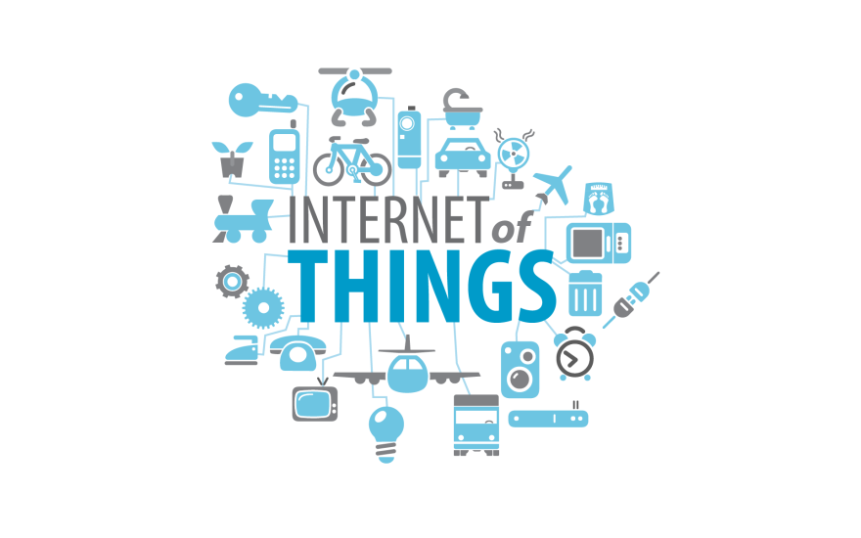
Home Automation System Introduction
1. Introduction
The term “The Internet of Things” (IoT) was coined by Kevin Ashton in a presentation to Proctor & Gamble in 1999. He is a co-founder of MIT’s Auto-ID Lab. He pioneered RFID (used in bar code detector) for the supply-chain management domain. He also started Zensi, a company that makes energy sensing and monitoring technology. The ‘Thing’ in IoT can be any device with any kind of built-in-sensors with the ability to collect and transfer data over a network without manual intervention. The embedded technology in the object helps them to interact with internal states and the external environment, which in turn helps in decisions making process. In a nutshell, IoT is a concept that connects all the devices to the internet and let them communicate with each other over the internet. IoT is a giant network of connected devices – all of which gather and share data about how they are used and the environments in which they are operated. By doing so, each of your devices will be learning from the experience of other devices, as humans do. IoT is trying to expand the interdependence in human that is interact, contribute and collaborate to things. Let’s understand this with an example.
A room temperature sensor gathers the data and send it across the network, which is then used by multiple device sensors to adjust their temperatures accordingly. For example, refrigerator’s sensor can gather the data regarding the outside temperature and accordingly adjust the refrigerator’s temperature. Similarly, your air conditioners can also adjust its temperature accordingly. This is how devices can interact, contribute & collaborate.

Slide 9
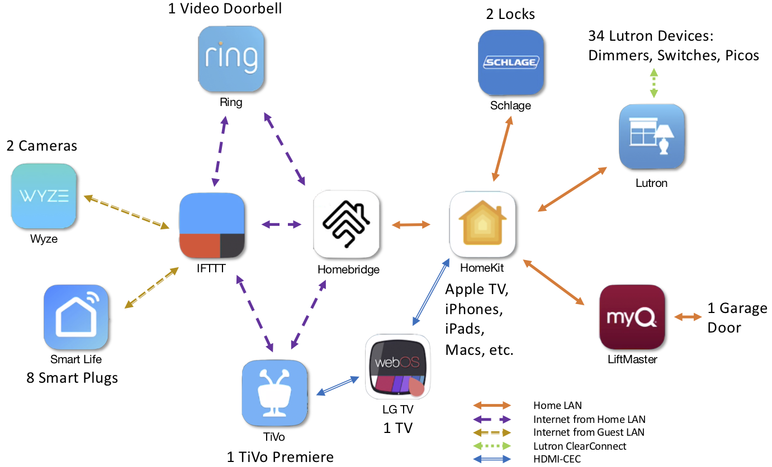
Home Automation System Introduction
1.1 Internet of Things Architecture

Slide 10
Home Automation System Introduction
1.2 Benefits of Internet of Things
Since IoT allows devices to be controlled remotely across the internet, thus it created opportunities to directly connect & integrate the physical world to the computer-based systems using sensors and internet. The interconnection of these multiple embedded devices will be resulting in automation in nearly all fields and also enabling advanced applications. This is resulting in improved accuracy, efficiency and economic benefit with reduced human intervention. It encompasses technologies such as smart grids, smart homes, intelligent transportation and smart cities. The major benefits of IoT are:
Improved Customer Engagement – IoT improves customer experience by automating the action. For e.g. any issue in the car will be automatically detected by the sensors. The driver, as well as the manufacturer, will be notified about it. Till the time driver reaches the service station, the manufacturer will make sure that the faulty part is available at the service station.
Technical Optimization – IoT has helped a lot in improving technologies and making them better. The manufacturer can collect data from different car sensors and analyse them to improve their design and make them much more efficient.
Reduced Waste – Our current insights are superficial, but IoT provides real-time information leading to effective decision making & management of resources. For example, if a manufacturer finds fault in multiple engines, he can track the manufacturing plant of those engines and can rectify the issue with manufacturing belt.

Slide 11
Home Automation System Introduction
1.3 Internet of Things Hardware
Now the main question is what the required hardware for is preparing an IoT solution. The answer to this question is, you’ll first require sensors that will sense the environment, then you require a remote dashboard to monitor your output and display it in a clearer & conceivable form. At last, you will require a device with the capability of serving & routing. The key task of the system would be detecting specific conditions and taking actions accordingly. One thing to keep in mind is securing the communication between the devices and the dashboard.
Some of the common sensors that you are surrounded by are accelerometers, temperature sensors, magnetometers, proximity sensors, gyroscopes, image sensors, acoustic sensors, light sensors, pressure sensors, gas RFID sensors, humidity sensors & micro flow sensors.
Nowadays we also have many wearable devices like smartwatches, shoes & 3D glasses. This is the best example of a smart solution. 3D glasses adjust television’s brightness and contrast according to your eye and your smartwatches keeps track of your daily activities and fitness.
But the most important device which has tremendously contributed to IoT are the cell phones. Mobile apps have immensely contributed to revolutionizing the technology world. Cell phones are already encased with applications and sensors that reveals lots of information about its user. It has Geo-location information, it can sense and trace light condition, the orientation of your device and a lot more information. It also comes with multiple connectivity options like Wi-Fi, Bluetooth and cellular that helps them to communicate with other devices. Thus, due to these default qualities of cell phones, it is the core of the IoT ecosystem. Today, Smartphone can interact with smartwatch and fitness band to further ease and enhance the user experience.
IoT uses multiple technologies and protocols to communicate with devices based on the requirements. The major technologies & protocols are Bluetooth, wireless, NFC, RFID, radio protocols and Wi-Fi-Direct.

Slide 12
Home Automation System Introduction
IoT applications are flourishing across all industries & market. The IoT has a multitude of expansion over various industries. It spans over all groups of users, from those who are trying to reduce & conserve energy in their home to large organizations who want to improve their business operations. IoT has not only proved itself useful in optimizing critical applications in many organisations, but also have boosted the concept of advanced automation which we have imagined a decade before. Let’s understand the capabilities of IoT across different industries and look how they are revolutionizing them.

Slide 13
Home Automation System Introduction
1.4 Internet of Things Various Domains
Energy Applications: The energy rates have raised to a great instinct. Individuals and organisations, both are searching ways to reduce and control the consumption. IoT provides a way to not only monitor the energy usage at the appliance-level but also at the house-level, grid level or could be at the distribution level. Smart Meters & Smart Grid are used to monitor energy consumption. It also detects threats to the system performance and stability, which protect appliances from downtime and damages.
Healthcare Application: Smartwatches and fitness devices have changed the frequency of health monitoring. People can monitor their own health at regular intervals. Not only this, now if a patient is coming to the hospital by ambulance, by the time he or she reaches the hospital his health report is diagnosed by doctors and the hospital quickly starts the treatment. The data gathered from multiple healthcare applications are now collected and used to analyse different disease and find its cure.
Education: IoT provides education aids which helps in fulfilling the gaps in the education industry. It not only improves the quality of education but also optimizes the cost and improves the management by taking into consideration students response and performance.
Government: Governments are trying to build smart cities using IoT solutions. IoT enhances armed force systems and services. It provides better security across the borders through inexpensive & high-performance devices. IoT helps government agencies to monitor data in real-time and improve their services like healthcare, transportation, education etc.

Slide 14
Home Automation System Introduction
Air and Water Pollution: Through various sensors, we can detect the pollution in the air and water by frequent sampling. This helps in preventing substantial contamination and related disasters. IoT allows operations to minimize the human intervention in farming analysis and monitoring. Systems automatically detect changes in crops, soil, environment, and more.
Transportation: IoT has changed the transportation sector. Now, we have self-driving cars with sensors, traffic lights that can sense the traffic and switch automatically, parking assistance, giving us the location of free parking space etc. Also, various sensors in your vehicle indicate you about the current status of your vehicle, so that you don’t face any issues while travelling.
Marketing your product: Using IoT, organizations can better analyse & respond to customer preferences by delivering relevant content and solutions. It helps in improving business strategies in the real-time.

Slide 15
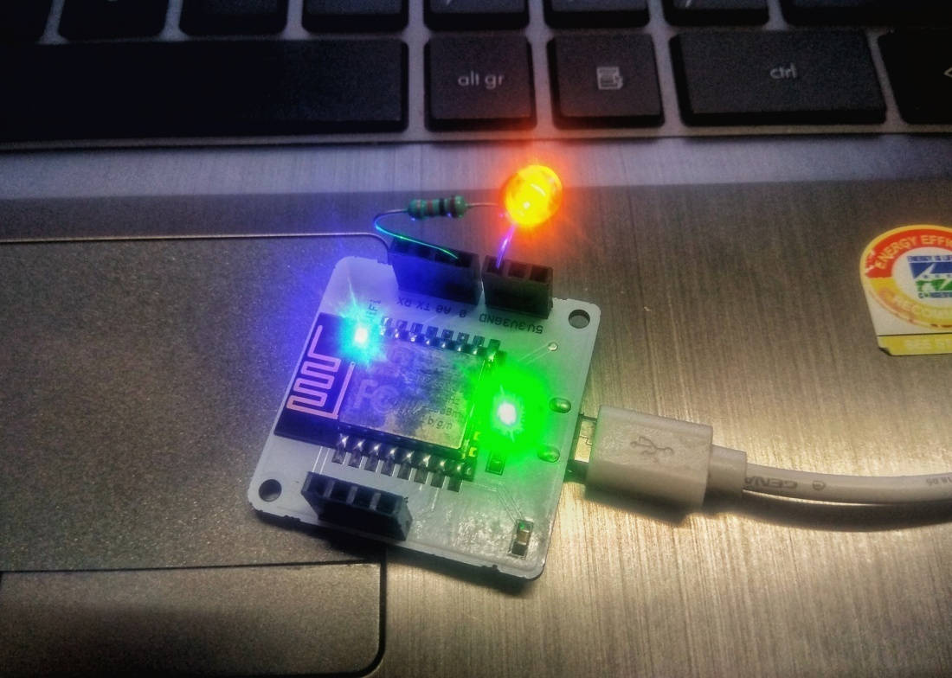
Home Automation System Introduction
1.5 About Project
The Home Automation System is built around Bolt Wi-Fi module and IFTTT Technology. The hardware set up should be according to the circuit diagram. The IFTTT technology is integrated with Bolt Wi-Fi Module through its Cloud server.
Here the Google Assistant based on IFTTT technology will help us to control the home appliances. This give freedom to control home appliances from anywhere in the World, through Voice. The only thing is need is that one Smartphone with good Internet Connection.

Slide 16
2.
Software Requirements

Slide 17
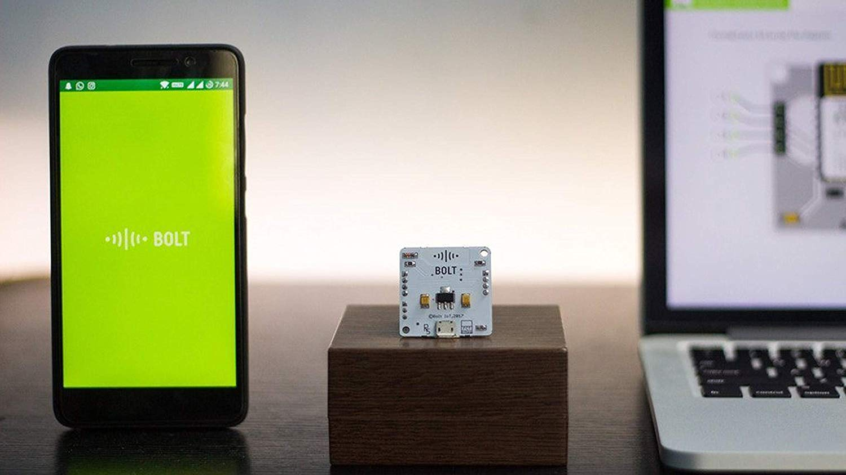
Home Automation System Software Requirements
2. Software Requirements
2.1 Bolt IoT Cloud
Remote Configuration
The Platform let’s you remotely configure and initialize the pins on your Bolt Wi-Fi module. Which means you can adapt to hardware setup changes that have been made remotely when you want to add more sensors or actuators to your existing product.
The configuration is highly intuitive because of the GUI based pin selector on the dashboard.
Code Editor
The Bolt Cloud gives you the option to code directly on the dashboard besides uploading the codes that you have saved offline. These codes that you build are your ‘products’ and can be linked to any of your Bolt devices Over the Air.
Smartphone App
To complete the platform is a mobile application for both Android and iOS which lets you link the Hardware to the Cloud and also loads the application you build for monitoring or control.

Slide 18
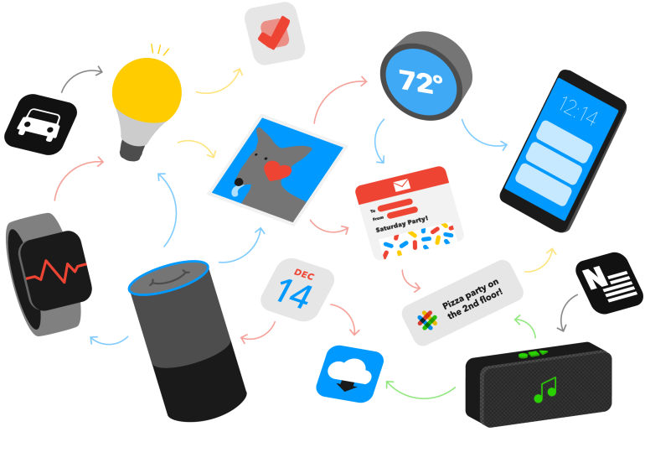
Home Automation System Software Requirements
Bolt API
The Bolt’s open API’s let you add as many tools as you want to the dashboard to create your unique applications which may include notifications, visualizations or custom mobile applications for your projects.
Sharing and Mass Deployment
The Platform allows you to share your devices with other members as well, so they can too monitor or control the product you have created for your home or workplace. You can remotely update all your nodes with a single click.
2.2 IFTTT
If This Then That, also known as IFTTT is a free web-based service to create chains of simple conditional statements, called applets.
An applet is triggered by changes that occur within other web services such as Gmail, Facebook, Telegram, Instagram, or Pinterest.
For example, an applet may send an e-mail message if the user tweets using a hashtag, or copy a photo on Facebook to a user's archive if someone tags a user in a photo.
In addition to the web-based application, the service runs on iOS and Android. In February 2015, IFTTT renamed its original application to IF, and released a new suite of apps called Do, which lets users create shortcut applications and actions. As of 2015, IFTTT users created about 20 million recipes each day. All of the functionalities of the Do suite of apps have since been integrated into a redesigned IFTTT app.

Slide 19
Home Automation System Software Requirements
Features : IFTTT employs the following concepts:
Services (formerly known as channels) are the basic building blocks of IFTTT. They mainly describe a series of data from a certain web service such as YouTube or eBay. Services can also describe actions controlled with certain APIs, like SMS. Sometimes, they can represent information in terms of weather or stocks. Each service has a particular set of triggers and actions.
Triggers are the "this" part of an applet. They are the items that trigger the action. For example, from an RSS feed, you can receive a notification based on a keyword or phrase.
Actions are the "that" part of an applet. They are the output that results from the input of the trigger.
Applets (formerly known as recipes) are the predicates made from Triggers and Actions. For example, if you like a picture on Instagram (trigger), an IFTTT app can send the photo to your Dropbox account (action).
Ingredients are basic data available from a trigger—from the email trigger, for example; subject, body, attachment, received date, and sender’s address.
Usage examples:
IFTTT can automate web-application tasks, such as posting the same content on several social networks.
Marketing professionals can use IFTTT to track mentions of companies in RSS feeds.
IFTTT also is used in home automation, for instance switching on a light when detecting motion in a room (with associated compliant devices).

Slide 20
3.
Hardware Requirements

Slide 21
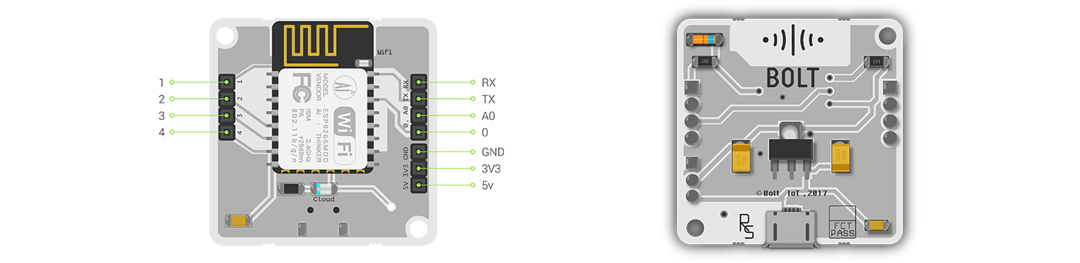
Home Automation System Hardware Requirements
3. Hardware Requirements
3.1 Bolt IoT Wi-Fi Module
Bolt Functionalities :
Station mode in which it can connect to Wi-Fi networks.
When not connected to any Wi-Fi network it hosts its own Wi-Fi hotspot to which
users can connect.
Commands an ATmega to do all GPIO and UART based tasks.
Runs at a frequency of 80Mhz.
Total of 12 Digital I/O pins are made available on Bolt
Namely pins 0,1,2,3,4,5,6 & 7 along with A0,A1,A2 & A3.
All work on 5 volt logic level i.e. HIGH = 5v = Binary 1 and LOW = 0v = Binary 0
In Output mode each pin can source a maximum current of 40mA but it is
recommended that user uses them for only 20mA max.
While using these as input (reading voltage values on the pin)the any voltage
below 2.5 Volts is considered as LOW and any Input above 2.5 is considered as
HIGH.
PWM pins
Pins 1,2,3,4,5 act as Hardware PWM pins.
You can give an output of 0-5V on these pins in steps of (5/256)= 0.02
approximately.

Slide 22
Home Automation System Hardware Requirements
Analog Read Pins
Pins A0,A1,A2 and A3 double up as channels used by the internal Analog to Digital
converter.
These can read any voltage between 0-5V. With a minimum measurable voltage of
0.005 approximately.
Technical Specifications :
Microcontroller - Mic32-bit RISC CPU: Tensilica Xtensa LX106
Operating Voltage – 3.3V
Powering Up
5V [USB]
5V [Battery Terminal]
Clock frequency : 80 MHz
64 KB of instruction RAM, 96 KB of data RAM
External QSPI flash - 4 MB
Wi-Fi – IEEE 802.11 b/g/n
Integrated TR switch, balun, LNA, power amplifier and matching networks
WEP or WPA/WPA2 authentication
Automatic AP mode if not connected to Wi-Fi
GPIO : 5
PWM : 5 (software PWM on GPIO pins)
ADC : 1 pin 10 bit ADC(0-1 volt)
UART on dedicated pins [Supported bauds: 2400/4800/9600/19200]
LED indicators
Wi-Fi LED – Indicates Wi-Fi connectivity
Slow blinking: Trying to connect / find network
Fast blinking: User has connected to Hotspot \ waiting for
configuration by user
Stable: Connected to Wi-Fi network
Off: No power to device / insufficient power
Cloud LED – Indicates connection to Bolt Cloud
Stable: Connected to Bolt cloud
Off: No Connection to Bolt Cloud
Dim: Insufficient power / false boot
Dimensions: 35mm x 35mm
Boot Time – Less than 1 Second

Slide 23
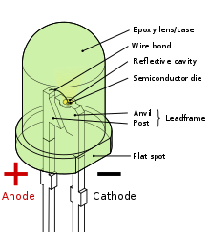
Home Automation System Hardware Requirements
3.2 LED ( Light Emitting Diode)
A light-emitting diode (LED) is a semiconductor light source that emits light when current flows through it. Electrons in the semiconductor recombine with electron holes, releasing energy in the form of photons. This effect is called electroluminescence. The color of the light (corresponding to the energy of the photons) is determined by the energy required for electrons to cross the band gap of the semiconductor. White light is obtained by using multiple semiconductors or a layer of light-emitting phosphor on the semiconductor device.
Appearing as practical electronic components in 1962, the earliest LEDs emitted low-intensity infrared light. Infrared LEDs are used in remote-control circuits, such as those used with a wide variety of consumer electronics. The first visible-light LEDs were of low intensity and limited to red. Modern LEDs are available across the visible, ultraviolet, and infrared wavelengths, with high light output.
Early LEDs were often used as indicator lamps, replacing small incandescent bulbs, and in seven-segment displays. Recent developments have produced high-output white light LEDs suitable for room and outdoor area lighting. LEDs have led to new displays and sensors, while their high switching rates are useful in advanced communications technology.

Slide 24
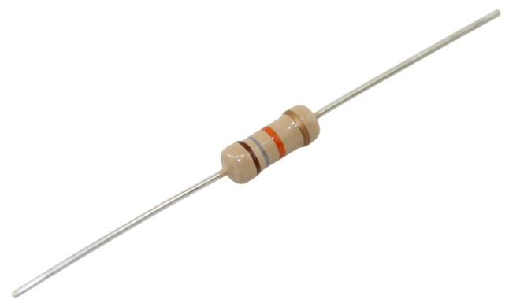
Home Automation System Hardware Requirements
LEDs have many advantages over incandescent light sources, including lower energy consumption, longer lifetime, improved physical robustness, smaller size, and faster switching. Light-emitting diodes are used in applications as diverse as aviation lighting, automotive headlamps, advertising, general lighting, traffic signals, camera flashes, lighted wallpaper and medical devices.
Unlike a laser, the color of light emitted from an LED is neither coherent nor monochromatic, but the spectrum is narrow with respect to human vision, and functionally monochromatic.
3.3 Resistor ( 10 K ohm )
A resistor is a passive two-terminal electrical component that implements electrical resistance as a circuit element. In electronic circuits, resistors are used to reduce current flow, adjust signal levels, to divide voltages, bias active elements, and terminate transmission lines, among other uses. High-power resistors that can dissipate many watts of electrical power as heat, may be used as part of motor controls, in power distribution systems, or as test loads for generators. Fixed resistors have resistances that only change slightly with temperature, time or operating voltage. Variable resistors can be used to adjust circuit elements (such as a volume control or a lamp dimmer), or as sensing devices for heat, light, humidity, force, or chemical activity.
Resistors are common elements of electrical networks and electronic circuits and are ubiquitous in electronic equipment. Practical resistors as discrete components can be composed of various compounds and forms. Resistors are also implemented within integrated circuits.
The electrical function of a resistor is specified by its resistance: common commercial resistors are manufactured over a range of more than nine orders of magnitude. The nominal value of the resistance falls within the manufacturing tolerance, indicated on the component.

Slide 25
4.
System Documentation

Slide 26
Home Automation System System Documentation
4. System Documentation
4.1 Software System Attributes
1. Reliability: The overall consistency of a measure.
A measure is said to have a high reliability if it produces similar results under consistent conditions.
2. Availability: The degree to which a system, subsystem or equipment is in a specified operable and committable state at the start of a mission, when the mission is called for at an unknown.
3. Security: Degree of resistance to any harm.
4. Portability: Using the same software in different environments.
5. Maintainability: Measures the ease and speed with which a system can be restored to operational status after a failure occurs.
6. Performance: To analyze if the system meets its goals.
PERFORMANCE REQUIREMENT
In order to assess the performance of a system, the following are necessary:
● Response
● Workload
● Scalability
● Platform

Slide 27
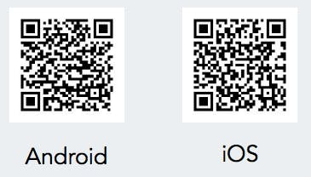
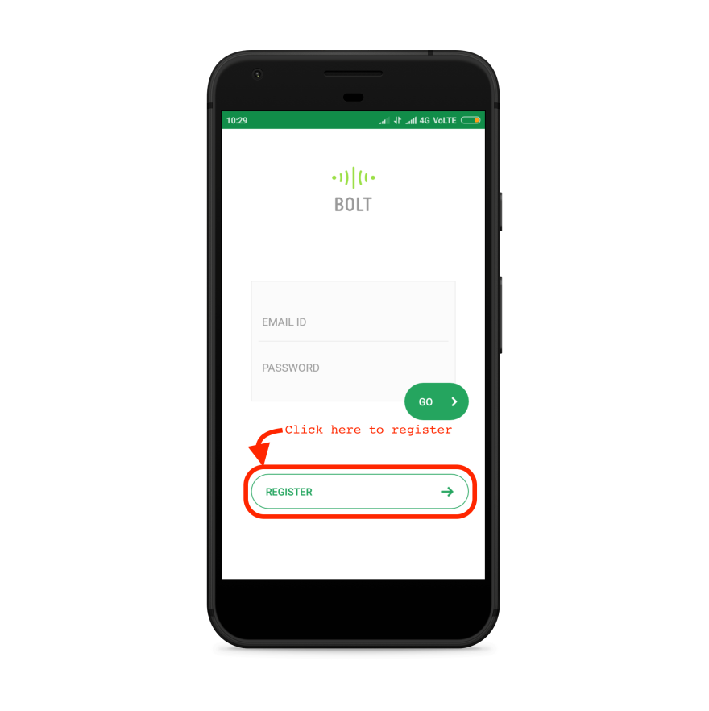
Home Automation System System Documentation
4.2 Scratch to Product
Setting up Bolt Wi-Fi Module :
Downloading Bolt App – Download the Bolt IoT App for Android or iOS. You can either search for Bolt IoT or scan the QR code below
Creating an Account – You will need to create an account on the Bolt Cloud to control the Bolt device. Open the Bolt App and click on 'REGISTER' to create a new account.

Slide 28
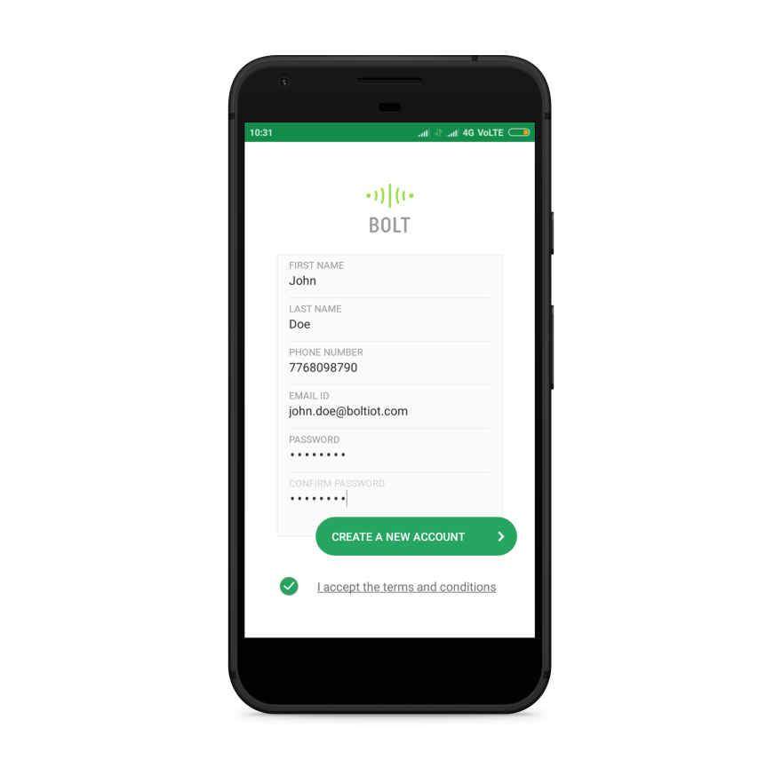
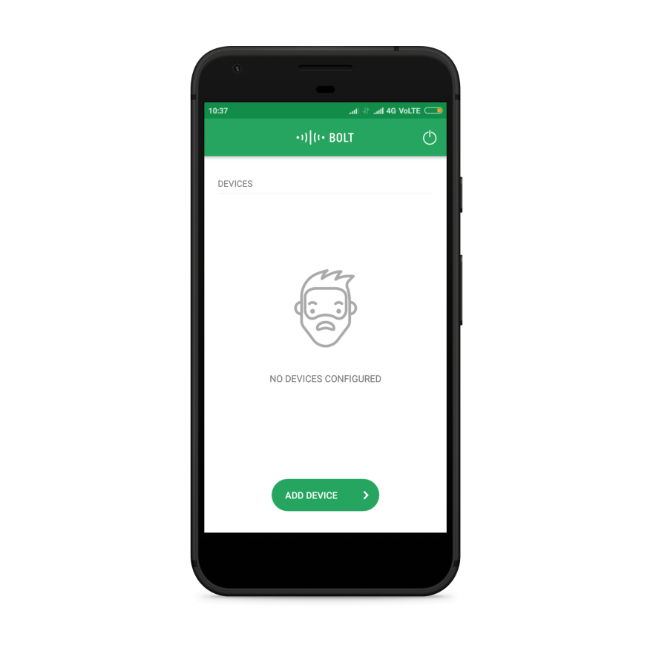
Home Automation System System Documentation
Fill all the required details and agree to the terms and conditions. Finally, click on
'CREATE A NEW ACCOUNT' to create your free account.
You will now receive an email on the email ID that you had given to verify your account. This is to verify that you are an actual human and not a robot. Follow the instructions in the email to activate your Bolt Cloud account. Now, pull down on the screen using your fingers to refresh the mobile App screen. Congratulations, you have activated your account. You will then be greeted with a screen that says that you don't have any Bolts Modules linked to your account.

Slide 29
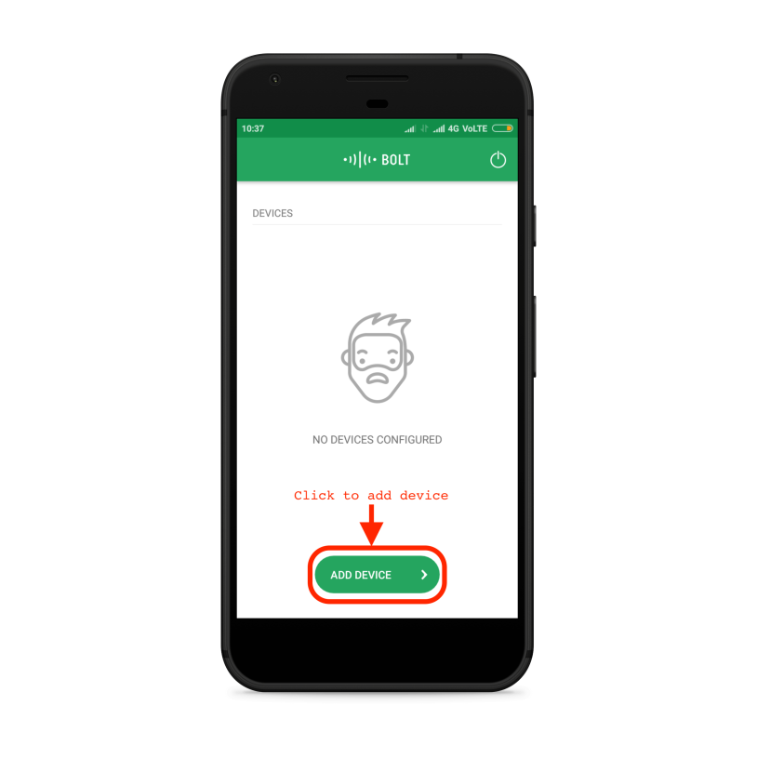
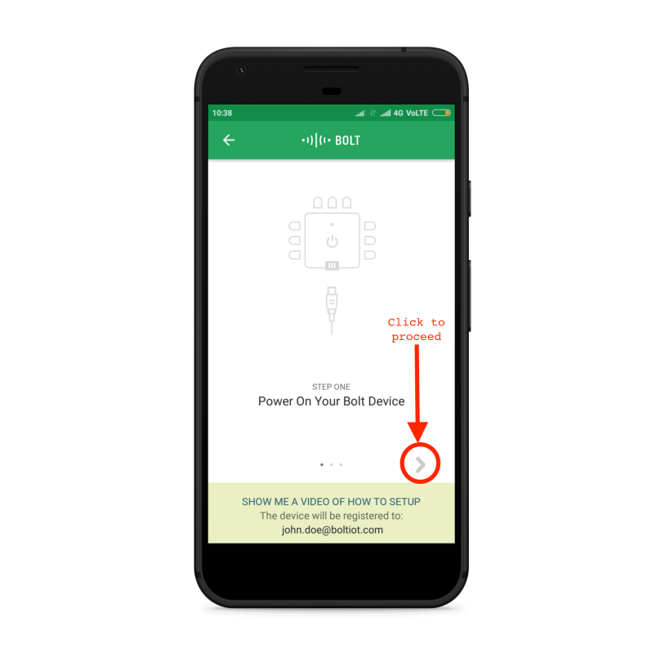
Home Automation System System Documentation
Adding Bolt to your Account – Now, click on the 'ADD DEVICE' button to setup your Bolt device with your Wi-Fi network.
Power ON the Bolt device by inserting the Micro USB cable into the USB port provided on the Bolt and connecting the other end of the cable to the Android charger or to your laptop.
Once you have powered ON the Bolt device, blue LED on the Bolt will begin to
blink slowly and the green LED will be OFF. When the blue LED blinks slowly, it
means that the Bolt is now transmitting its own Wi-Fi hotspot network and is ready
to be setup via the Bolt IoT App on your phone. Click on the '>' symbol on the app
to progress further.

Slide 30
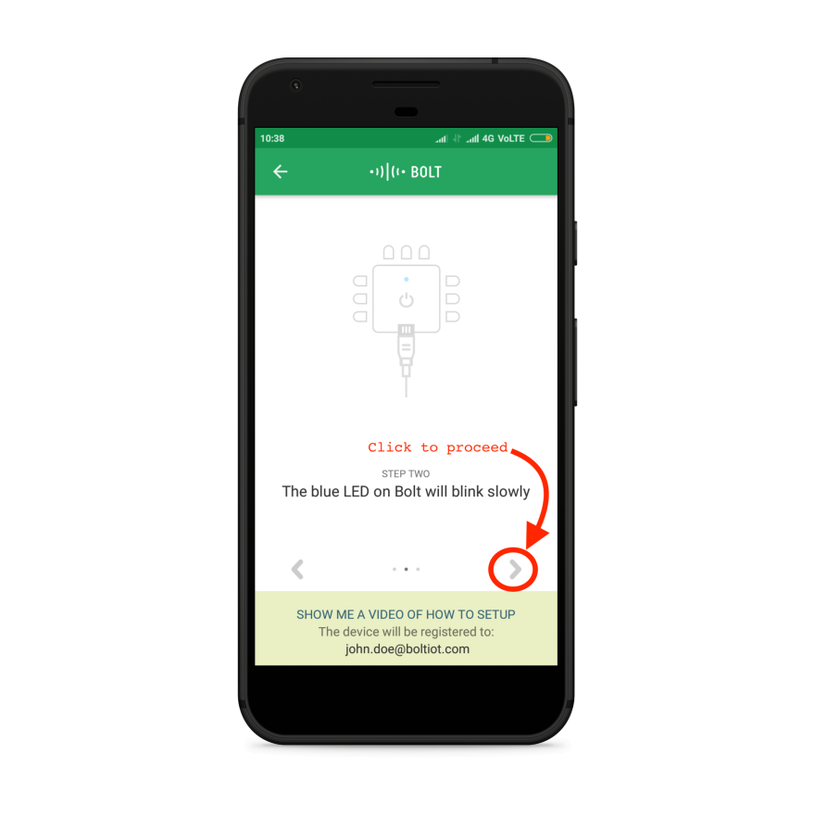
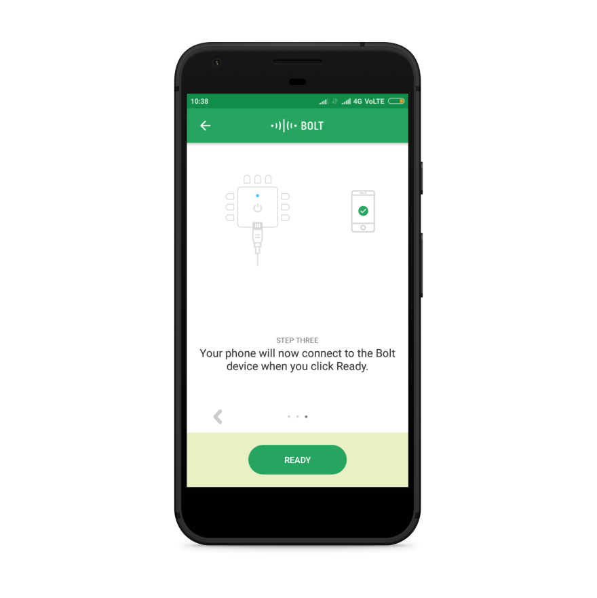
Home Automation System System Documentation

Slide 31
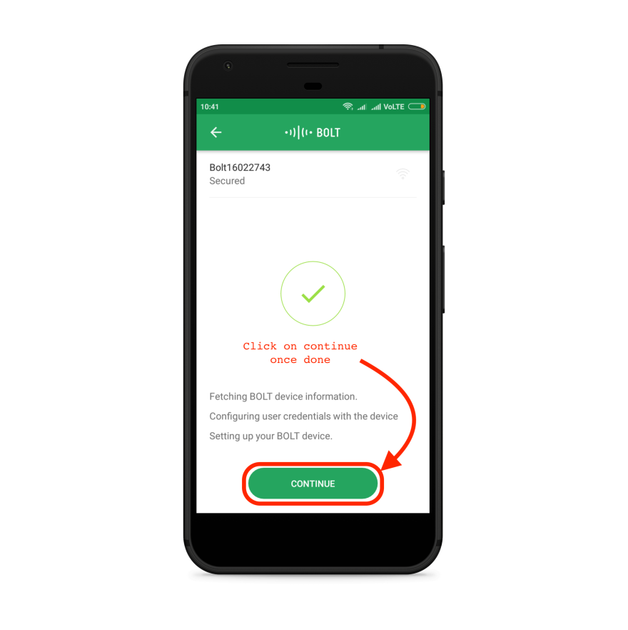
Home Automation System System Documentation
For Android Only: Before proceeding further, kindly switch OFF your mobile data
and switch ON the location service in your mobile if not already and click on the
"READY" button. This is required only in the Android App due to APIs by Google.
We do not collect or store any of your location data. If the Bolt has been
detected by the App, it will show a screen similar to the one below. The blue LED
on the Bolt will now blink fast. This means that it is under the setup process. To
proceed, click on 'CONTINUE'.
The password for the WiFi hotspot transmitted by the Bolt WiFi Module is: bolt1234 While setting up with the Android mobile app, your mobile phone will
automatically connect to the hotspot when you click next. On an iOS, you will
have to connect to the Hotspot by going to your Setting -> Wi-Fi.
Now, we will need to tell the Bolt which Wi-Fi network it has to connect to.
Note: The Bolt WiFi module cannot detect 5 GHz based WiFi networks and will not
be able to connect to it.
Select the WiFi network to which Bolt has to be connected. You can click on the
WiFi name to choose the WiFi network to connect to.
Note: For the iOS App, you will have to manually enter the SSID or the WiFi Name
of the device you want to connect to.

Slide 32
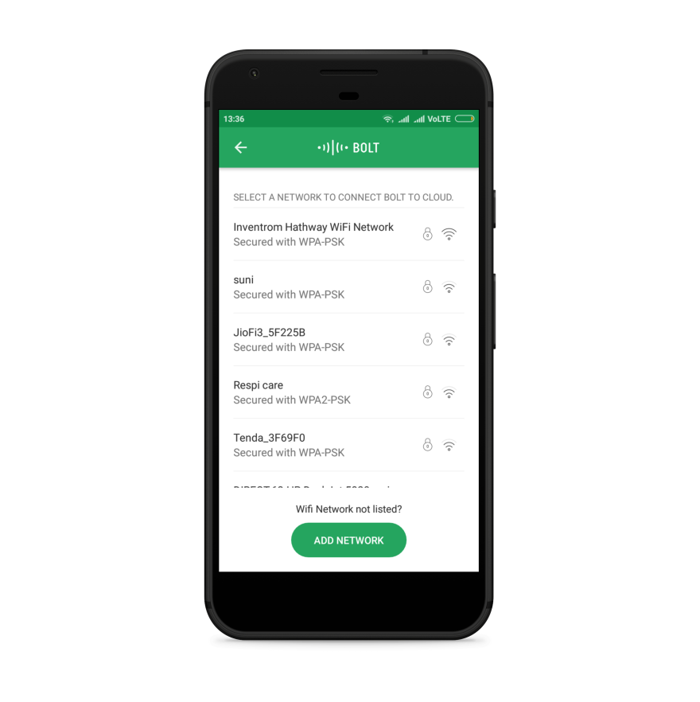
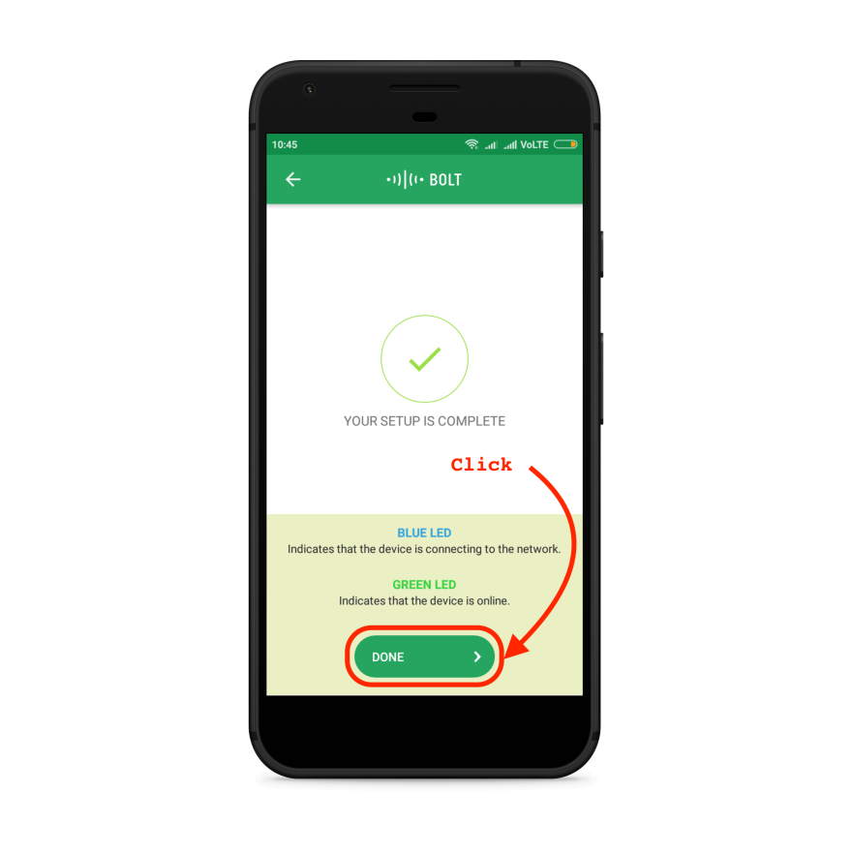
Home Automation System System Documentation
The App will now send the WiFi credentials to the Bolt WiFi Module.
Now, click on 'DONE' and in the next screen, select your Country and click on
'SAVE' to complete the final step of the setup.

Slide 33
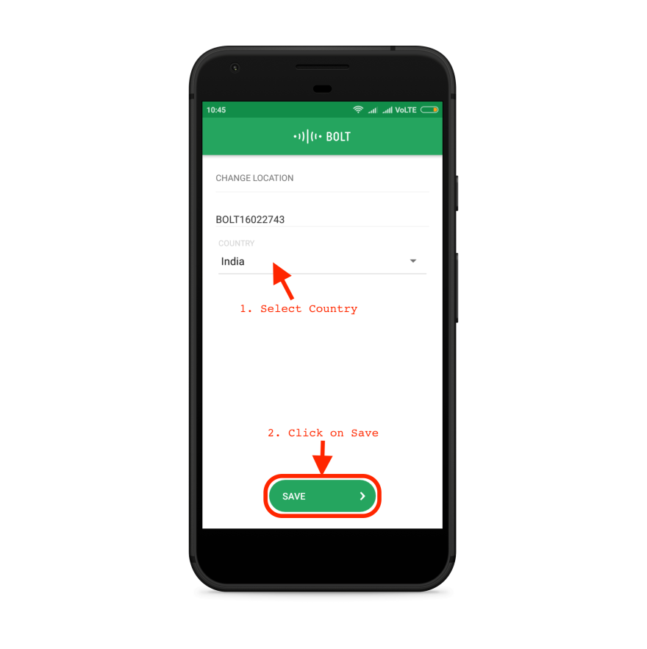
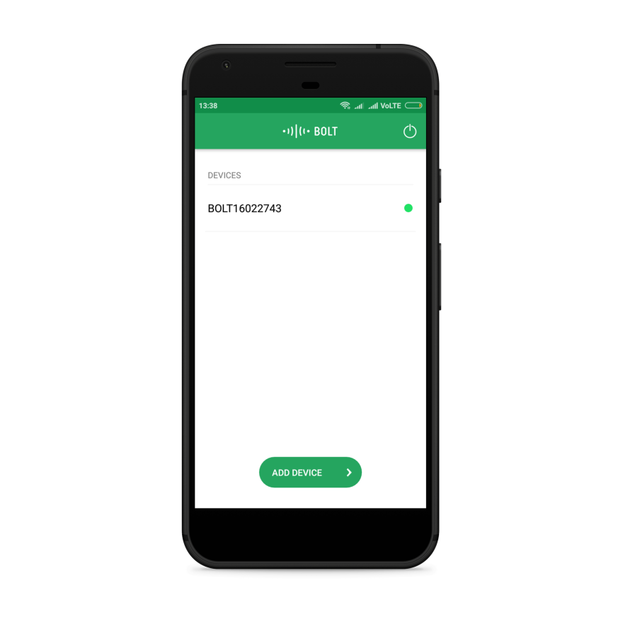
Home Automation System System Documentation
Now, click on 'DONE' and in the next screen, select your Country and click on
'SAVE' to complete the final step of the setup.
If everything has gone according to plan, the Bolt device will now restart
automatically. The blue and green LED on the Bolt device will now be glowing
steadily.
If the Bolt was able to connect to the Wi-Fi network and is connected to the
cloud, a green dot will appear beside the Bolt's device ID as shown below.
Debugging:
If the Bolt is unable to connect to the WiFi network, the green LED will be OFF and the Blue LED will be blinking slowly. This generally happens if you have entered the wrong WiFi credentials (SSID or password) at the time of setup. Please try the setup process once again with the correct WiFi credentials.
Check if your WiFi Router works at 2.4GHz. Bolt does not support 5GHz at the moment.

Slide 34
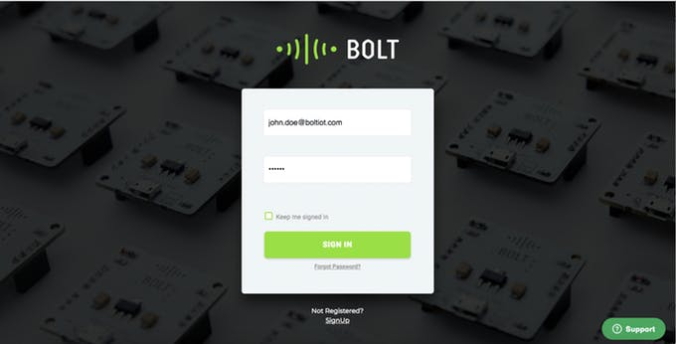
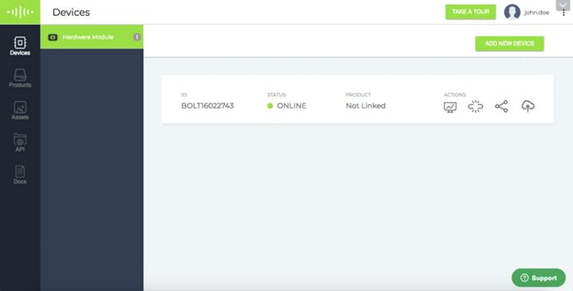
Home Automation System System Documentation
Debugging:
If the Bolt is unable to connect to the Wi-Fi network, the green LED will be OFF and
the Blue LED will be blinking slowly. This generally happens if you have entered the
wrong Wi-Fi credentials (SSID or password) at the time of setup. Please try the
setup process once again with the correct Wi-Fi credentials.
Check if your Wi-Fi Router works at 2.4GHz. Bolt does not support 5GHz at the
moment.
Accessing the Bolt Cloud to Build IoT Projects – Visit Bolt Cloud
(cloud.boltiot.com) and login into your registered account using the same email
ID and password that you have used on the Bolt IoT mobile App.
You will see your Bolt device with status as 'ONLINE' on your account on the dashboard.

Slide 35
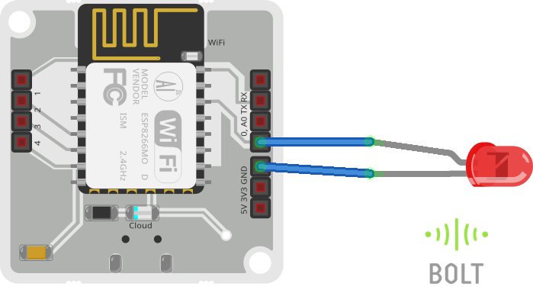
Home Automation System System Documentation
Hardware Setup
Plug the longer end of the LED in the Pin 0 of Bolt Wi-Fi module shorter end to the ground pin (GND), and power on the Bolt Wi-Fi module.
Schematics
It shows how to interface the LED with Bolt Wi-Fi Module.

Slide 36
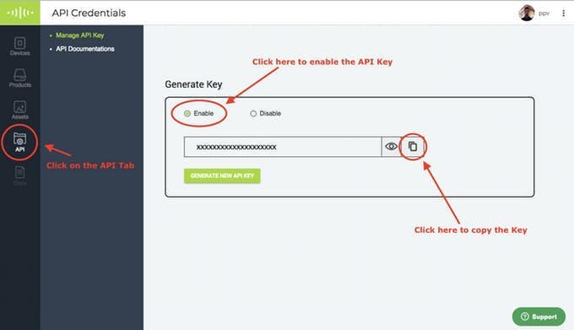
Home Automation System System Documentation
Getting the Bolt API Key and Device ID
Login to cloud.boltiot.com and note the ID of your Bolt Wi-Fi Module. Now click on the API Tab and under the section for Generate Key, click on Enable.
Next click on the copy button to copy your API key. Your API key will may look something like this: f1f918e9-d9c2-4e5b-aed0-b7cb743f74cf
Creating the GPIO Control Command
Since LED is a digital output device, we will need to get a Digital Write command
that can be sent to Bolt over the Internet to switch on the LED. The structure of the
command is:
https://cloud.boltiot.com/remote/API_KEY/digitalWrite?pin=PIN_ NUMBER&state=HIGH
/LOW&deviceName=DEVICE_ID
The parameters that you need to replace are:
API_KEY: You can get it from API tab on cloud dashboard. PIN_NUMBER: Pin to which you have connected the LED. Values can be either
0,1,2,3 or 4 HIGH/LOW: This value indicates if you want to turn on/off the LED. HIGH will turn it
on, LOW will turn it off.

Slide 37


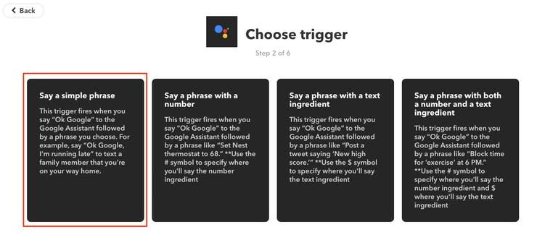
Home Automation System System Documentation
DEVICE_ID: The id of your device. You can get it from cloud dashboard.
The sample command to turn the led ON connected to device having
ID BOLT6097833 to PIN 0 is:
https://cloud.boltiot.com/remote/d4976f53-357e-47fe-a33c-6a427773215b/
digitalWrite?pin=0&state=HIGH/LOW&deviceName=BOLT6097833
Make sure that you change the API Key to your own API Key and device ID which
you got in the previous step. If you have connected the LED to any other pin
other then Pin 0 then make a suitable change in the pin no in your code.
IFTTT integration via Google Assistant and Webhooks
Go to IFTTT to create a new applet. Login using your Gmail account. Make sure
you use same account which you'll be using on your mobile to interact with
Google Assistant.
Click on '+This' to create the trigger.
Choose Google Assistant -> Say Specific Phrase

Slide 38
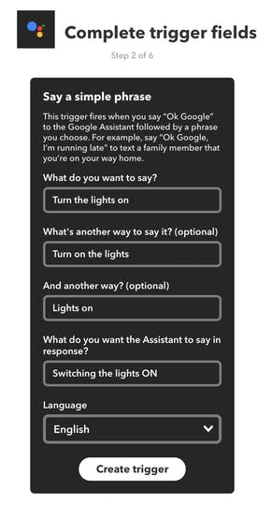

Home Automation System System Documentation
Type the phrase you want to trigger the action. Make sure to specify the trigger
command in different ways :
a) Turn the lights on
b) Turn on the lights
c) Lights on
Click on 'Create Trigger'
Click on '+That'

Slide 39
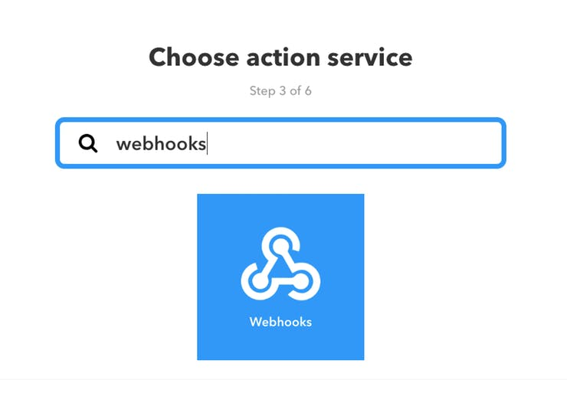
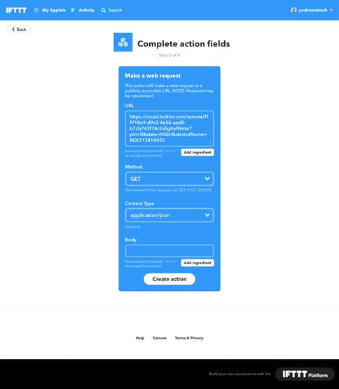
Home Automation System System Documentation
Select Webhooks and then Make a web request.
Enter the API URL you got in the previous Step. Make sure that you change the API Key and device name.
Method will be GET.
Content type will be Application/json.

Slide 40
Home Automation System System Documentation
Click on 'Create Action' and then Click on 'Finish'
Steps to turn OFF the LED
Now do the same process for a command to switch of the LED. Here you will
change the state to LOW i.e. state=LOW in your code. Here is a sample of the
code. Also, add a suitable phrase to switch off the LED.
https://cloud.boltiot.com/remote/f1f918e9-d9c2-4e5b-aed0-
b7cb743f74cf/digitalWrite?pin=0&state=LOW&deviceName=BOLT13819450

Slide 41
5.
Testing & Result

Slide 42
Home Automation System Testing
5. Testing
Prototyping model has been used in developing this project , where at each step refinements have been made. Manual testing has been done in order to ensure the quality of product. The Home Automation System is a low cost, based on Voice controlled product. This system can easily control majorly all the home appliances.
5.1 Flow Chart
START
Initialize System Peripheral
Google Assistant Active on hearing, “ OK Google “
Does the Command match with the Command set in the IFTTT
NO
YES
Turn the Light On / Off
RETURN

Slide 43
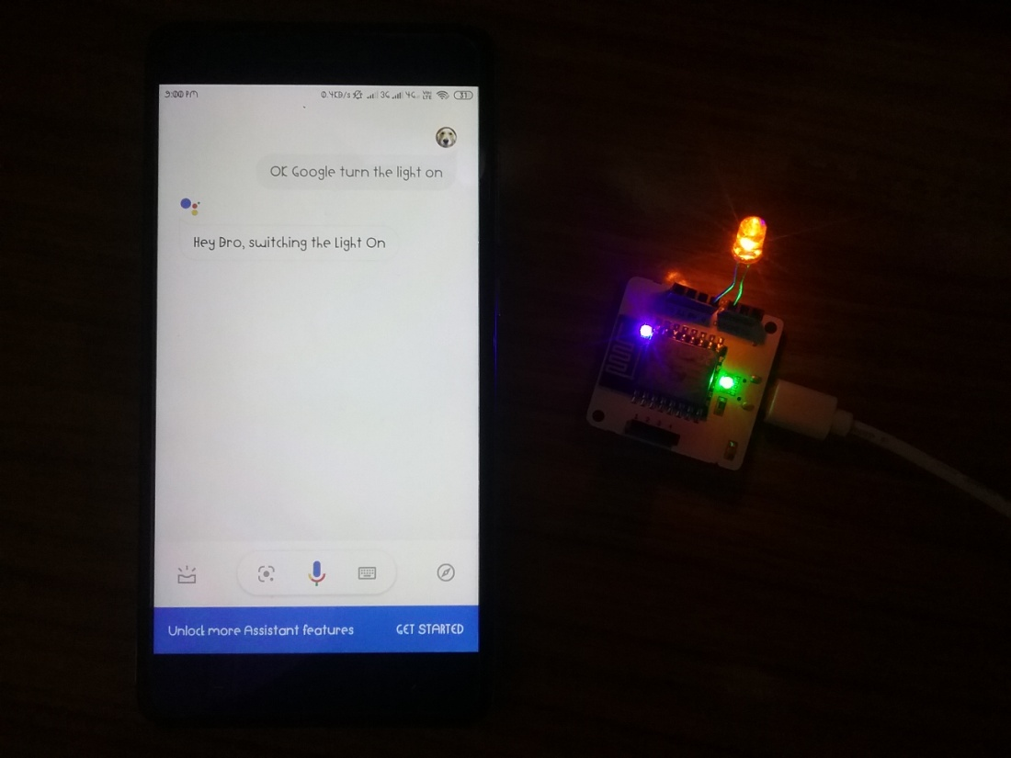
Home Automation System Testing
5.2 Result
Now wake the Android phone by saying “OK Google” and say the phrase “Turn the Light On” which had set while creating the Trigger. Also make sure that the Google Assistant of your phone my connected to Gmail Account.
The result was positive and the system responded well. The diagram above shows the complete prototype implementation of the proposed system.

Slide 44
Home Automation System Conclusion
Conclusion
The aim of this Project was to propose a cost effective voice controlled (Google Assistant) home automation controlling general appliances found in one’s home. The approach discussed in the Project was successful as GACHA’s (Google Assistant Controlled Home Automation) design was successfully implemented. This system is highly reliable and efficient for the aged people and differently disabled person on a wheel chair who cannot reach the switch for the switching ON/OFF the device and are dependent on others.
The future scope for GACHA can be huge. There are many factors to improve on to make GACHA more powerful, intelligent, scalable, and to become better overall for home automation. For example, controlling the speed of the fan, more number of devices can be integrated, like a coffee machine, air conditioner etc. Well, no system is ever perfect. It always has a scope for improvement. One just needs to put on a thinking cap and try and make the system more better.
Bibliography
https://cloud.boltiot.com
https://ifttt.com
https://www.hackster.io/bolt/projects
https://docs.boltiot.com/docs
https://assistant.google.com/
https://webhooks.pbworks.com/
https://www.json.org/

